Slide 1

Writing Resolution
European Parliament

Slide 2
The Regulation
The regulations are are the final document produced and approved by the European Parliament and the European Council, which expresses the collective will and contains measures aimed at resolving the topics under discussion.
The Regulations are the official output of your negotiation happened during your working sessions as representatives of the member states of the European Council.

Slide 3
The Regulation
Formal Requirements
The Conclusions, being an official document, HAVE a FIXED STRUCTURE and MUST respect the following formal requirements:
 | MS/HS/UNI
No. of Pages | No limit
Font | Times New Roman
Font Size | 10
Format | DOC or PDF
Spacing | 1
Language | British English

Slide 4
The Regulations
General Structure
Heading: it contains the institution’s name, the topic and the names of the political group leaders “on behalf” of the political group.
Legislative Clauses: they highlight previous EU and international actions undertaken on the issue.
Pre-ambulatory clauses: they state all the reasons
why the institution is working on an issue.
Operative clauses: they state the solutions that the sponsors of the resolution propose to solve the issues.

Slide 5

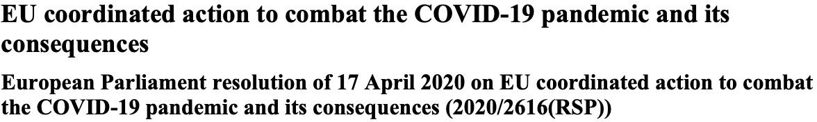

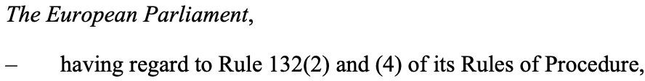


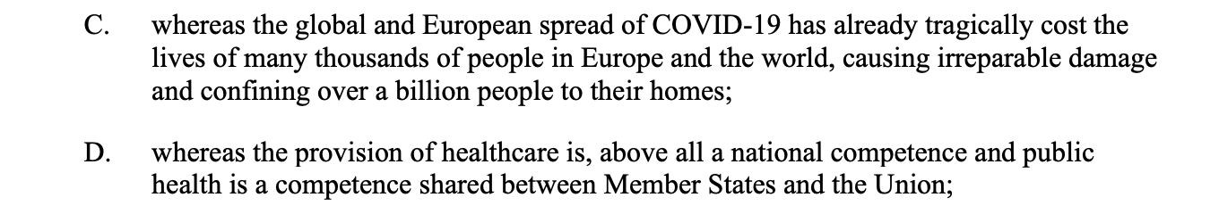

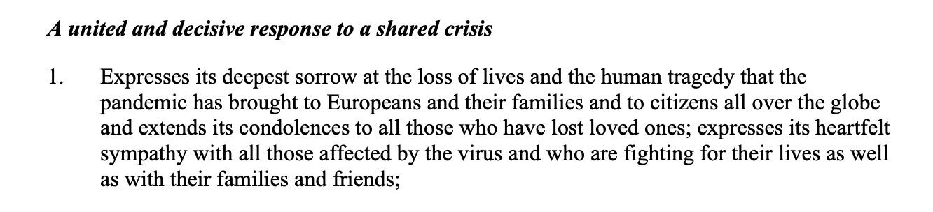

Example of Regulation
Heading
Legislative clauses
The European Council,
Type to enter a caption.
Pre-ambulato ry clauses
Type to enter a caption.
Operative clauses
Type to enter a caption.
5
Type to enter a caption.

Slide 6
Legislative clauses
Legislative clauses represent the legislative documents already approved and which form the normative basis for the topic under discussion.
Legislative clauses can include:
Past EU legislative acts, treaties, or conventions related to the topic.
Past regional, non-governmental, or national efforts in resolving this topic.
References to the EU Treaties or other international frameworks and laws.

Slide 7



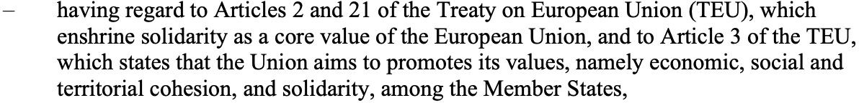



The Regulation
Legislative Clauses
Legislative clauses always begin with “having regard”, and end with a comma.
It starts with Having regards
Times New Roman 10, single spacing and end with comma

Slide 8
Pre-ambulatory clauses
Pre-ambulatory clauses represent the political background and reasons according to which the EU Institutions involved should discuss and solve the topic proposed.
Pre-ambulatory clauses can include:
Relevant data and statistics in order to understand the topic.
Statements made by the Presidents or any relevant EU body or agency.
Political reasons and directions to discuss and solve the topic.

Slide 9



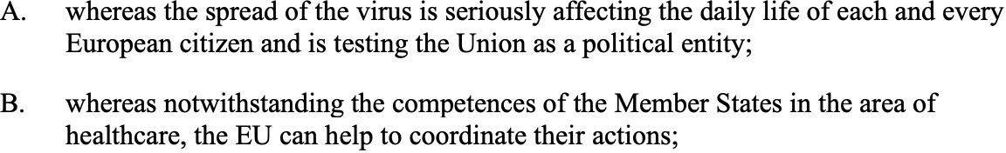








Pre-ambulatory clauses
P.C. starts with “Whereas”
Each P.C. is lettered
Times New Roman 10, single spacing and end with semi-colon

Slide 10
Operative Clauses
They represent the operative and enacting part of the conclusions since they contain ideas, programs, and new strategies to solve the problem of the topic under discussion. They recommend the EU institutional setting to take particular actions.
Each clause must contain one single solution that should not be repeated in following clauses. If there are more solutions connected to one another, they must be written in a logical order.
These clauses must analyse important aspects of the proposed solutions, such as raising funds, facilities, staff, and whatever is necessary to give coherence and strength to the proposal.

Slide 11
The Structure
Since they represent the articles of the law, operative clauses must be consecutively numbered.
They must begin with a title, representing the content of the article.
Each Article ends with a full stop.

Slide 12
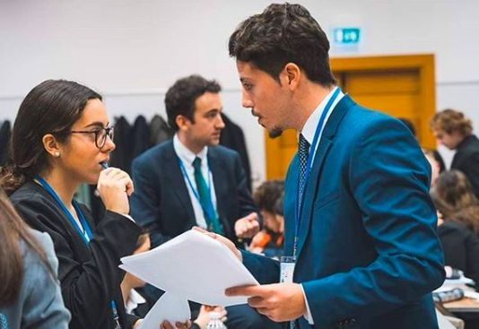
The Conclusions
Approval Procedure

Slide 13
The Conclusions
Important Information
Before starting to discuss the approval of the conclusions it’s important to remember and understand:
You will NOT work individually on the conclusions. The goal is to create a coalition that shares your same or at least a similar point of view on the topic.
There maximum number of Resolutions that a political group can propose is one. After the first day, member states will form coalitions between each other to reach the absolute majority if not unanimity in the PE. The proposed Resolutions which receive the higher numbers of votes will be the one approved by the PE.

Slide 14

The Voting Procedures

Slide 15
Moving to the Voting Procedures
Closure of Debate
When on the Dais’ table there is at least one Draft set of resolutions, the delegates can ask for the Closure of Debate (see RoP). At this point, the committee is ready for the last part of the simulation: the Voting Procedure.
IMPORTANT: When the Closure of Debate passes, all proposals that still have not been submitted will be immediately rejected.

Slide 16
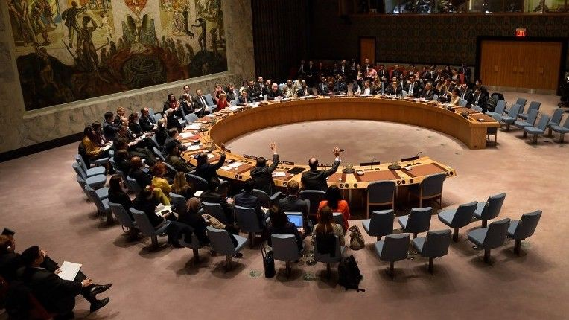
The Voting Procedures
During the Voting Procedure, the delegates will only present and vote the Draft Conclusions previously produced.
During this phase, delegates must maintain the highest level of Decorum. It is forbidden to:
Send private messages;
Propose motions;
Exit and re-enter the room.

Slide 17
Presentation of the Draft Conclusions
The representatives of the sponsor political group will have the right to present their Draft Conclusions. The presentation will be done as follows:
The draft conclusions will be projected;
5 min of presentation;
5 min of Q&A;
Vote on the Draft conclusions (simple majority required)
It will be at discretion of the President to give extra time to Q&A in case there is some time left.

Slide 18
The vote
In this phase, delegates express their approval (or not) on each Draft Resolutions which has been drawn up by each coalition.
The Draft Resolutions who gets the most votes will be approved.
Each delegation must express their vote or publicly abstain from the vote.
You can vote by Raising Placards, the standard procedure of the vote.

